Slide 1
Ready for 100
Ready for 100 Ohio
Sierra Club

Slide 2
New Community Orientation - Ready for 100
Agenda
What is Ready for 100?
Why do we need cities to commit to 100% renewable energy?
What does a commitment to 100% clean energy look like?

Slide 3
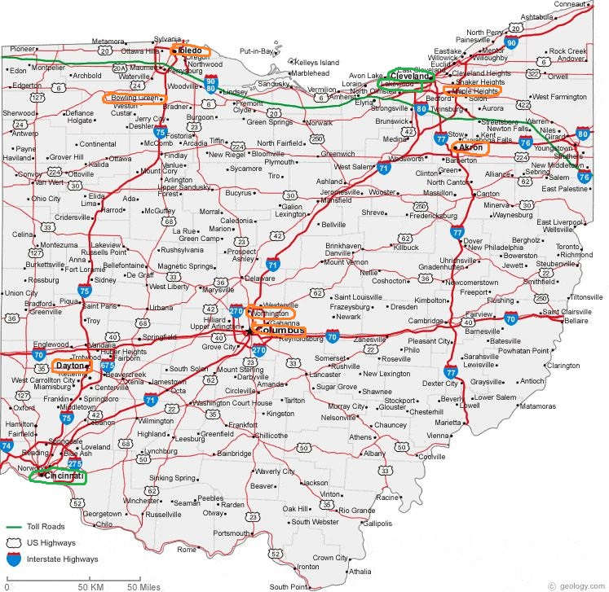
Ready for 100 Ohio
Part of Sierra Club
Cities committed
Cleveland
Cincinnati (100)
Lakewood (141)
Mayors committed
Bexley
Maple Heights
Active campaigns
Columbus
Dayton
Dublin
Marietta
Toledo
Worthington

Slide 4
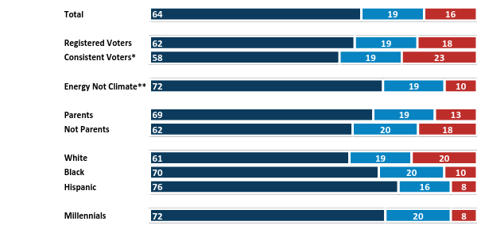
Americans broadly and intensely support the goal
Having read about this idea, do you support or oppose making this a goal for the United States? (1-10 SCALE, SHOWN ACROSS VERSIONS)
Strongly support (8-10)
Somewhat support (6-7)
Oppose (1-5)
*”Always” vote in non-Presidential years
**Rate increasing toward renewable energy as 8+ on 1-10 scale of priority but not combating climate change
Notes:
These are results from a national online survey of 2000 voter aged adults conducted by Global Strategy Group, commissioned by HereNow and Sierra Club
We asked people to rate their support for a goal of 100% clean energy by 2050 across the entire United States
Not only are people supportive, but they’re very willing to take action to make 100% a reality

Slide 5
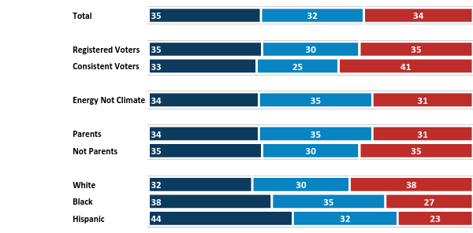
Despite their support, Americans initially split on how realistic a long-term clean energy goal is
And how realistic do you think this goal is? (1-10 SCALE, SHOWN ACROSS VERSIONS)
Very realistic (8-10)
Somewhat realistic (6-7)
Not realistic (1-5)
Notes:
The problem is that people feel it may be hard to achieve because of a lack of political will and obstruction from fossil fuel companies
Research shows that belief in 100% renewable energy increases as people are exposed to the clean energy successes happening across the U.S. and the world.
As people see and hear more about 100% renewable energy, they are also more inclined to take action in support of this goal.
The Ready for 100 Campaign will demonstrate that a clean energy transition is underway and 100% possible.

Slide 6
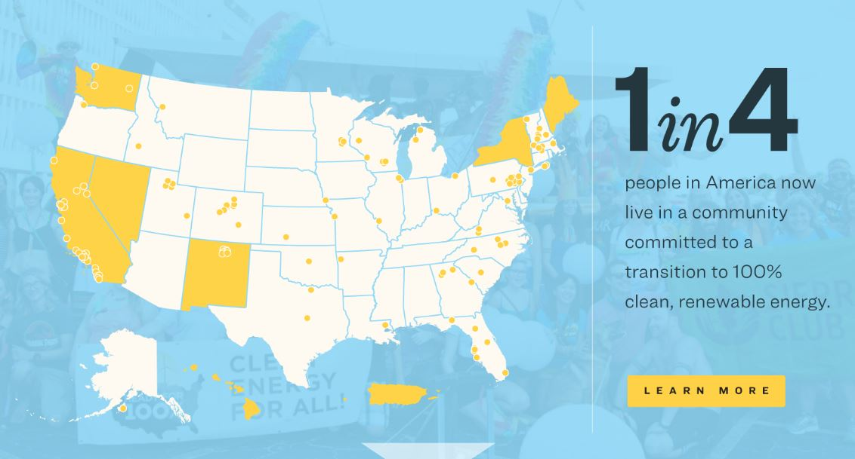
Ready for 100 Nationwide
Notes:
As of this week we have commitments from
163 cities – includes Cleveland, Cincinnati (#100), and Lakewood
13 counties
8 states – California, Hawaii, Maine, Nevada, New Mexico, New York, Virginia, Washington
District of Columbia, Puerto Rico
→ 100 million people or 1 in 3 in the US now live in a city or state committed to 100% renewable energy.
Over 50 cities now run on100% renewable energy
Aspen, Colorado
Burlington, Vermont
Georgetown, Texas
Greenburg, Kansas
Kodiak Island, Alaska
Rockport, Missouri
These commitments are through legislation passed by city councils, with steps and milestones incorporated into city climate plans
Some committed to 100% electricity, some to 100% electricity and transportation
Some committed by 2050, but most by 2030, 2035 or 2040
Cleveland committed to 100% renewable electricity by 2050, Cincinnati by 2035

Slide 7
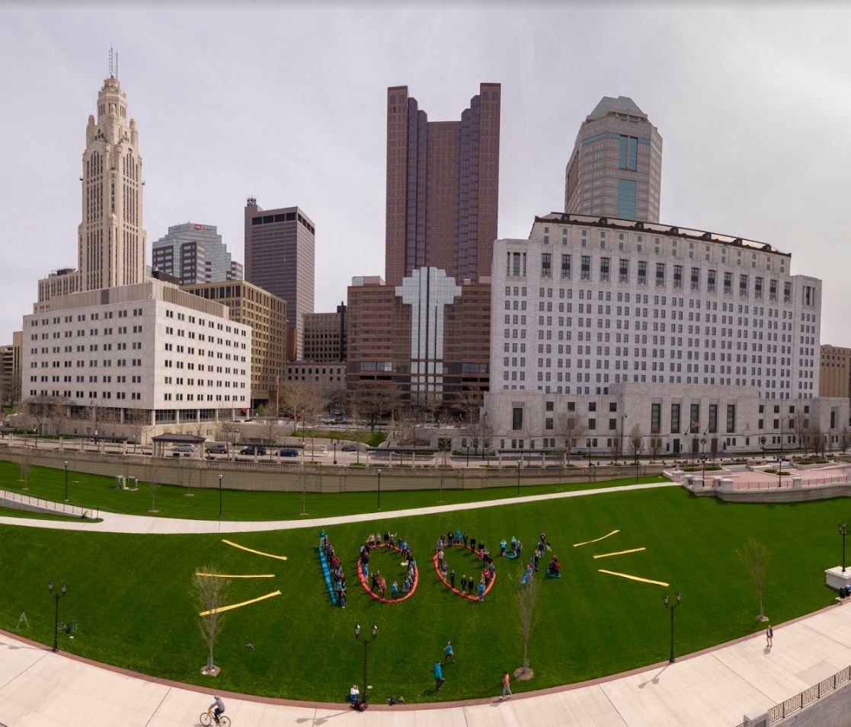
Ready for 100 Columbus
Why cities?
IPCC says we must cut carbon emissions 45% by 2030 and 100% by 2050
Cities are responsible for 70% of carbon emissions
Ohio is the 6th-highest carbon emitting state
Ready for 100 Columbus Aerial Art Event – Earth Day 2018

Slide 8
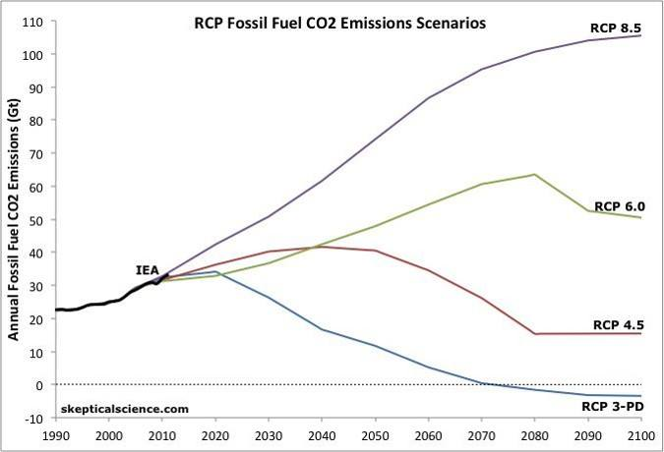
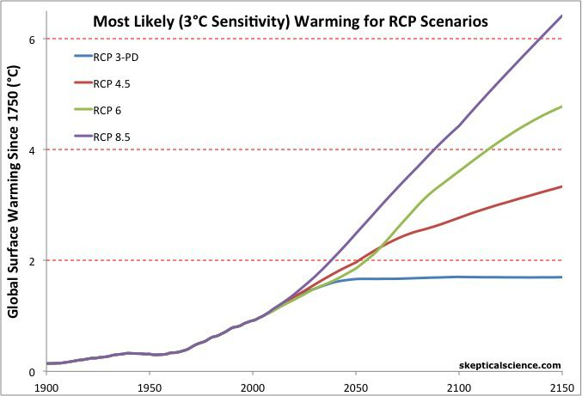
Paris Agreement is not enough
The Science
We are at 1C warming since Industrial Revolution
Paris Agreement has goal of limiting warming to 1.5C
Even if all countries meet their Paris pledges, we end up at 2.7C
To stay under 2C, we must get to zero emissions by 2050
In other words, we must get to 100% renewable energy

Slide 9
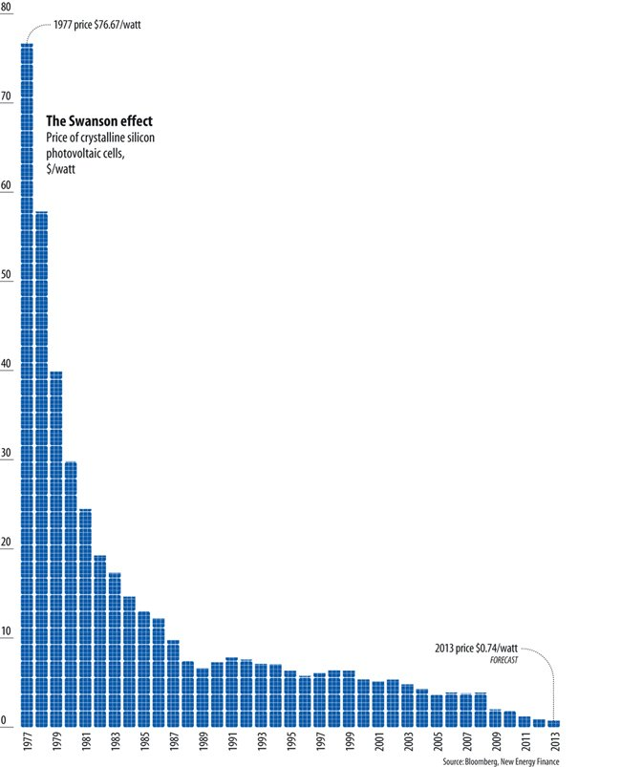
We can do this!
Solar and wind
Cheapest sources of electricity
Fastest-growing jobs in US
Solar energy
Enough for demand 121x over
Cost fallen 99% in past 40 years, 70% in US in last deca
World capacity 650 GW in 2019 – 71.3 GW in US
US potential is 155,000 GW
Wind energy
Enough for demand 40x over
Cost fallen 95% in past 40 years
World capacity 600 GW in 2018 – 105 GW in US, may quadruple
$1 trillion investment by 2040
Notes:
Wind and solar are the cheapest sources of electricity generation for people across more than two-thirds of the world today.[4*]
In 2000, the International Energy Agency projected global wind capacity would only reach 30 gigawatts (GW) by 2010. Instead in 2010, it reached 200 GW.[5*]
Total capacity worldwide will likely more than double between 2018 and 2027, with additions averaging around 65 GW per year. Much of the capacity will be in China, with 24 GW expected each year after 2020.[6*]
WIND
Wind energy has the potential to supply the world’s electricity needs 40 times over.[1*]
Global wind capacity reached almost 600 GW in 2018[2*], and is expected to quadruple by 2040, with $3.3 trillion in investments.[3*]
Wind and solar are the cheapest sources of electricity generation for people across more than two-thirds of the world today.[4*]
In 2000, the International Energy Agency projected global wind capacity would only reach 30 gigawatts (GW) by 2010. Instead in 2010, it reached 200 GW.[5*]
Total capacity worldwide will likely more than double between 2018 and 2027, with additions averaging around 65 GW per year. Much of the capacity will be in China, with 24 GW expected each year after 2020.
SOLAR
The cost of solar has dropped significantly in recent decades and has tremendous potential in the future.
In the US, solar installation costs fell by more than 70 percent in the last decade alone and hit a record low in the third quarter of 2019.[2*] Globally, the cost of solar PV has fallen by 99 percent over the last four decades.[3*]
Solar prices have fallen to the point of cost competitiveness with conventional generation technologies (fossil fuels), even without government subsidies.[4*]
In a single hour, the Earth receives more solar energy than humans use in a full year.[5*] It’s just a matter of harnessing what we need.
In 2017, the average solar panel converted 17 percent of all solar energy to usable electricity. Projections show this conversion efficiency could grow to roughly 25 percent by 2027.[6*]
The US is estimated to have over 190,000 GW of technical solar energy potential, including nearly 155,000 GW of solar PV capacity.[7*] In the third quarter of 2019, installed solar capacity reached 71.3 GW, enough to power 13.5 million homes.[8*]

Slide 10
100% by 2050 across the U.S. is possible
Notes:
Stanford engineers develop state-by-state plan to convert U.S. to 100% clean, renewable energy by 2050 – The Solutions Project
Mark Z. Jacobson and colleagues show that it's technically possible for each state to replace fossil fuel energy with entirely clean, renewable energy.
Our vision is to accelerate clean energy and energy savings in our homes buildings and cars to squeeze out dirty energy power our country with 100% renewable energy by 2050
Every car, train and bus will run on electricity, and that electricity will be generated by wind and solar.
Those cars and trains and buses won’t just be for transportation, they’ll be massive mobile storage solutions that will help to manage an increasingly distributed grid.
The reality is that this future is already here, it’s just unevenly distributed and it’s on us to spread the wealth of the clean energy economy.

Slide 11
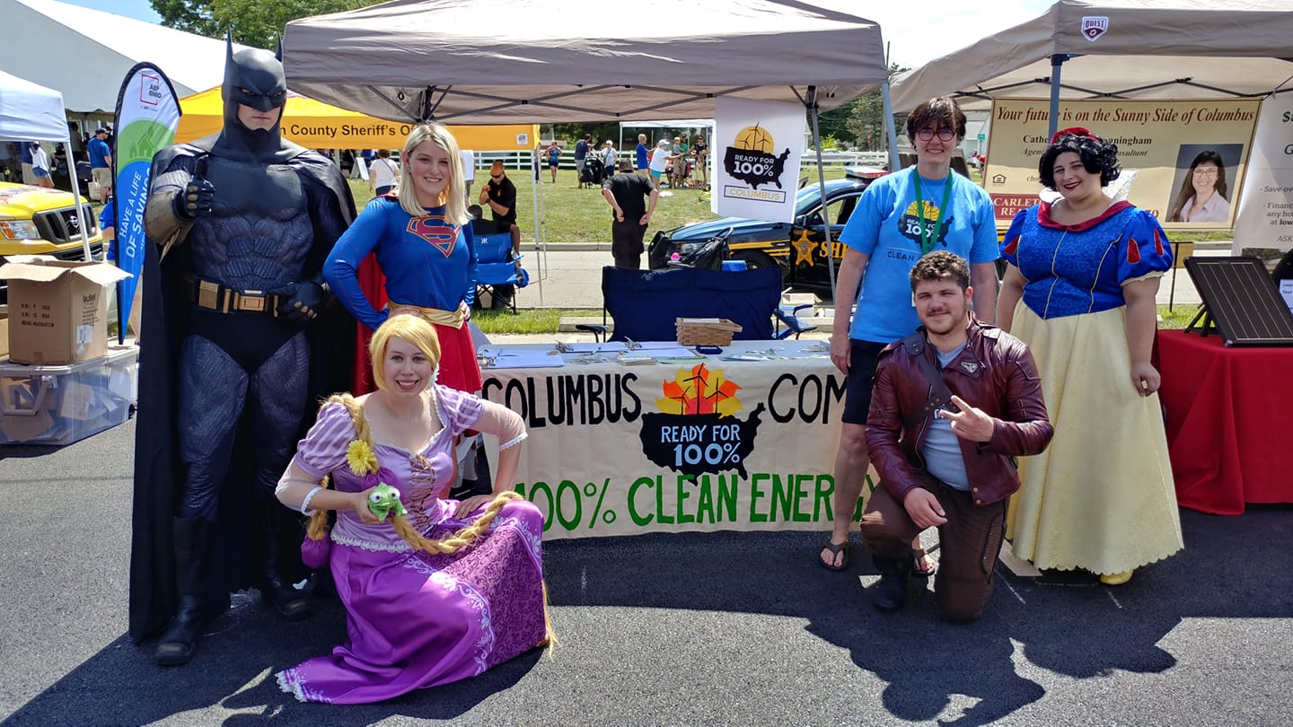
What does 100% clean energy look like?
Getting to 100%
Invest in energy efficiency
Promote renewable energy
Transportation through EVs, public transit, alternate modes
Green the energy supply
Use creative financing mechanisms

Slide 12
What does 100% clean energy look like?
Energy efficiency
Buildings are a top emitter
Efficiency upgrades to city, commercial, residential buildings
Equity issues
Energy burden
Split incentive
Policies
Benchmarking ordinance
Home energy audits
“Round it up” on utility bills
Net Zero police station in Cincinnati
Notes:
Columbus – 58% of emissions

Slide 13
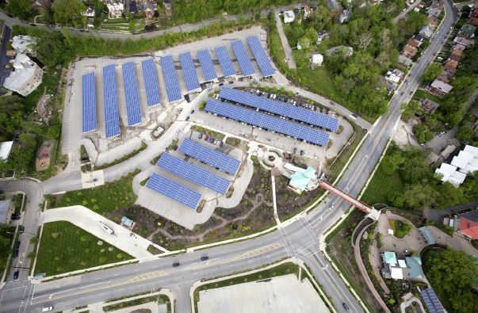
What does 100% clean energy look like?
Renewable energy
City buildings and property
Parks, schools
Homes and businesses
Bulk purchase through solar coops
Utility-scale renewable energy
Policies
Leverage through aggregation
Rooftop “rentals”
Participate in legislative and regulatory proceedings
Solar array over Cincinnati Zoo parking lot

Slide 14
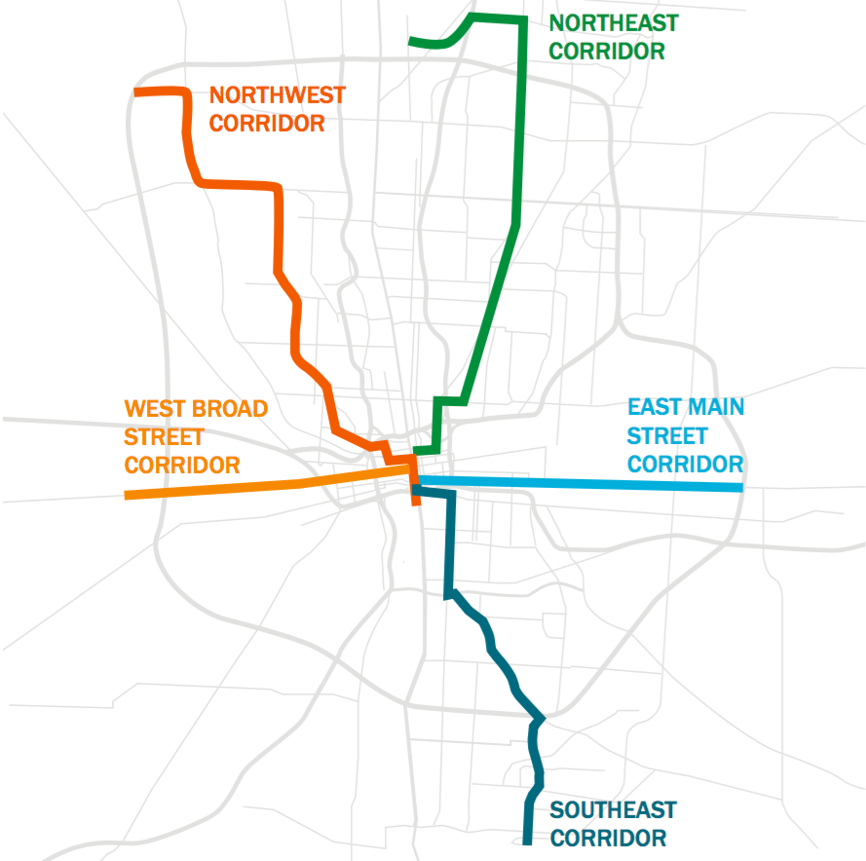
What does 100% clean energy look like?
Transportation
Electric vehicles
Transition city fleets
Build out charging infrastructure
Provide driver education on EVs
Public transportation
Bus rapid transit, light rail
Alternative transport
Safe bike lanes, sidewalks
Shared bikes, scooters
Policies
Smart growth
Smart Columbus EV Ride and Drive Roadshow ad

Slide 15
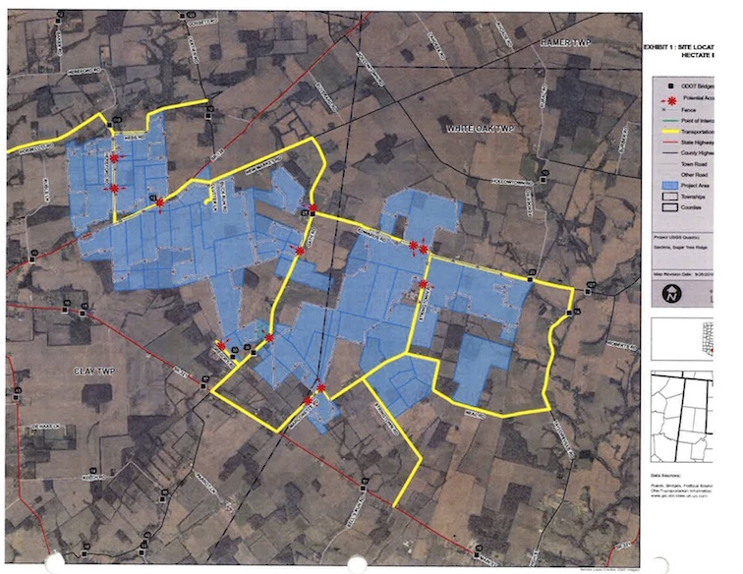
What does 100% clean energy look like?
Energy supply
Community Choice Aggregation
Legal in 9 states, proposed 5 more
Basis of Cincinnati’s commitment
Pools all city customers
“Collective bargaining for energy”
Requires a ballot initiative
Worthington passed CCA by 75%
Columbus will vote in November
Where does energy come from?
Renewable Energy Certificates
Local utility scale solar – Cincinnati
Map of Highland County solar array - Hecate
Notes:
States with Community Choice Aggregation
California, Illinois, Massachusetts, New Jersey, New York, Ohio, Rhode Island
States that have passed CCA but not yet implemented
New Hampshire, Virginia
States with proposed legislation
Arizona, Colorado, Connecticut, Maryland, Oregon
https://leanenergyus.org/cca-by-state/

Slide 16
What does 100% clean energy look like?
Creative Financing
Property Assessed Clean Energy
Commercial PACE
Residential PACE
Solar coops / bulk purchase
Solarize
Solar United Neighbors
“Round it up” programs
“Roof rental” programs
Green Banks
PNC Bank Plaza Columbus
Notes:
PNC Plaza is a 24-story building on Capital Square in downtown Columbus.
Columbus-Franklin County Finance Authority financed $3.2 million in energy efficiency improvements
Upgrades will save the company about $199,000 a year
Repaid through property taxes through PACE program

Slide 17
What does 100% clean energy look like?
Process
Equity, affordability, access
All members of the community
Clean and renewable only
Solar, wind, hydropower, geothermal
No fracked gas or nuclear
Transparent inclusive process
Stakeholder meetings
Public documents
RF100 Community Dialogue Columbus

Slide 18
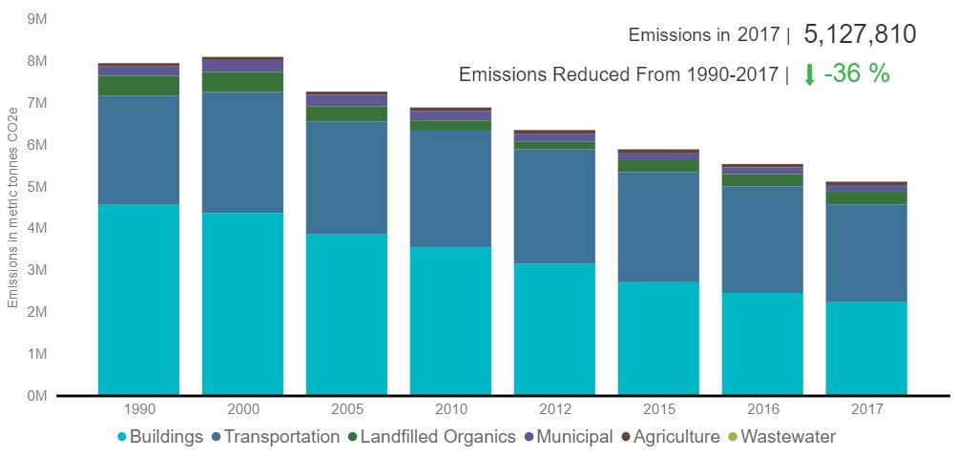
Does it work?
San Francisco
Began 100% commitment in 2011

