Slide 1
A Climate Minsky Moment: Carbon Bubble & Stranded Assets
Fadhel Kaboub
Associate Professor of Economics, Denison University
President, Global Institute for Sustainable Prosperity
@FadhelKaboub @GISP_Tweets
Global-ISP.org
kaboubf@denison.edu
ESGX Webinar
May 26, 2020

Slide 2
The Minsky Moment
Hyman Minsky (1919-1996)
Financial Instability
“Stability breeds instability”
“Stability is destabilizing”
Hedge-->Speculative -->Ponzi finance
Stabilizing an Unstable Economy (1986)

Slide 3
The Carbon Bubble & Stranded Assets
A $20 Trillion Carbon Bubble
$1-4 Trillion in oil/gas stranded assets
$1 Trillion in stranded real estate assets in the US alone

Slide 4
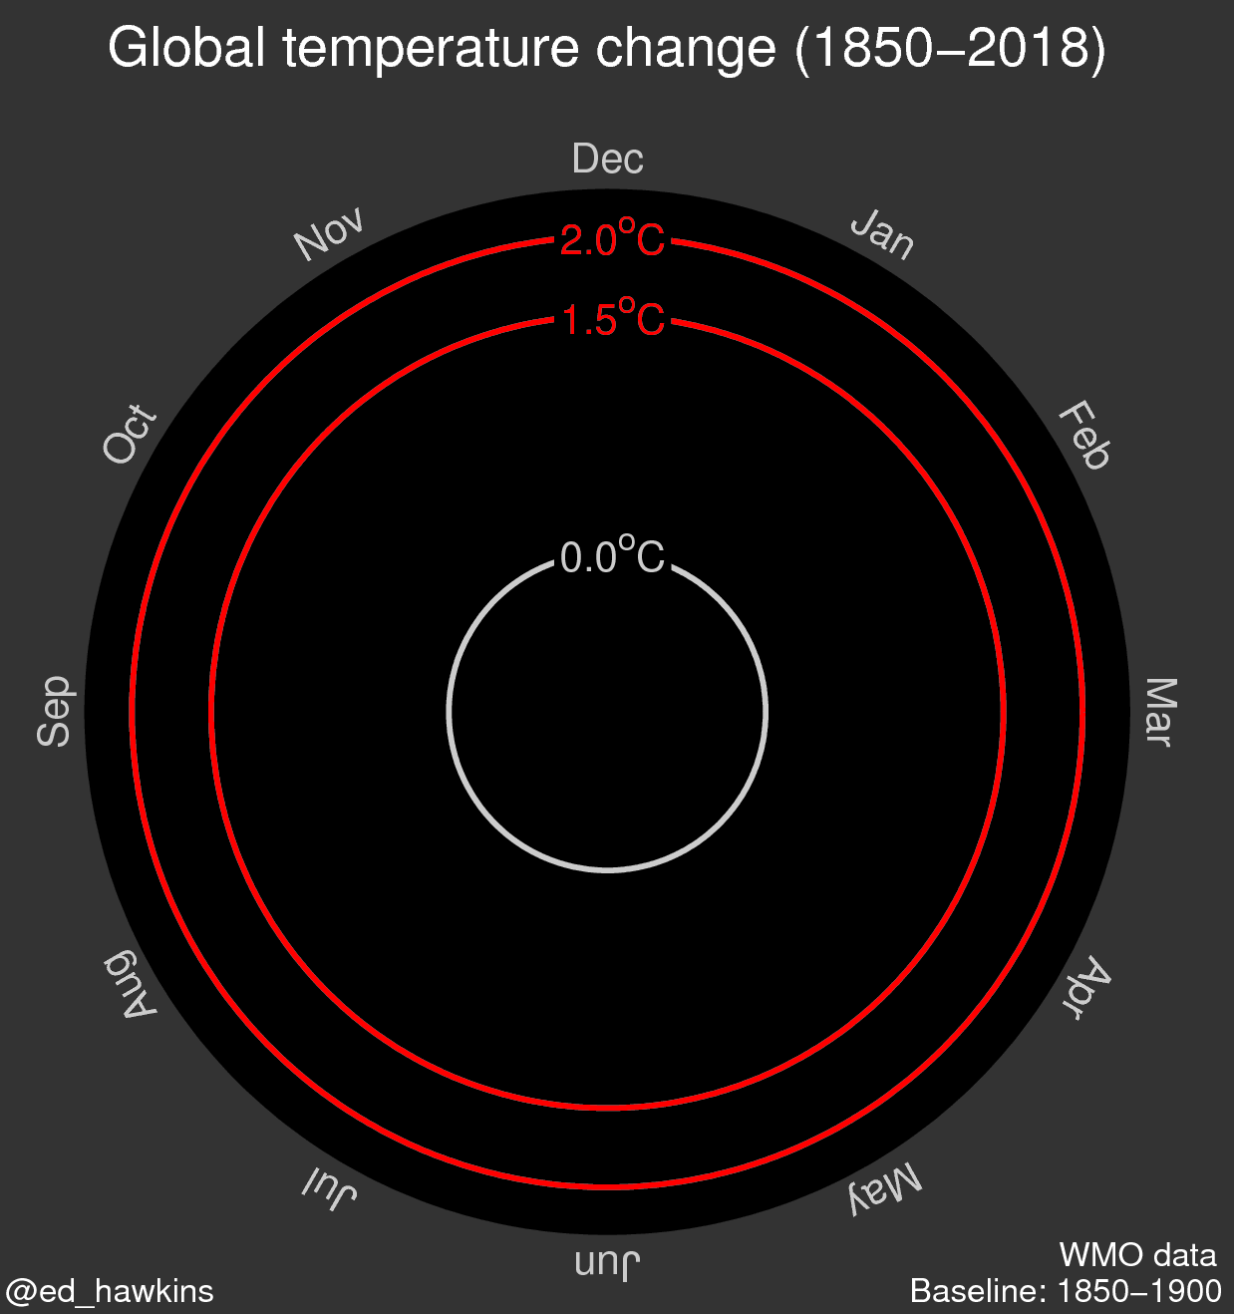

Slide 5
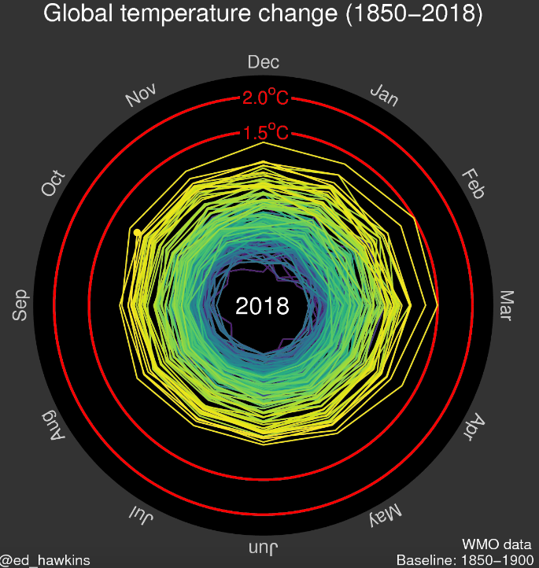

Slide 6
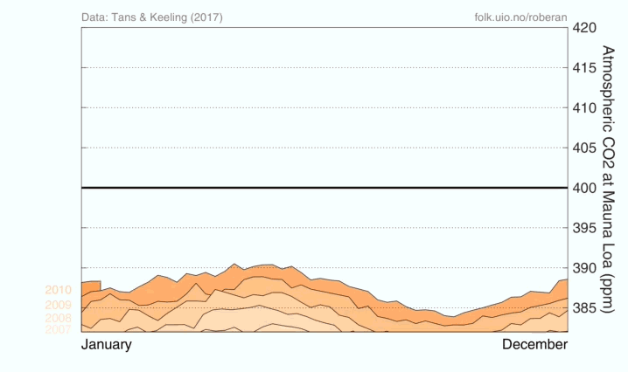
Atmospheric CO2 Concentration (ppm) as of March 2018

Slide 7
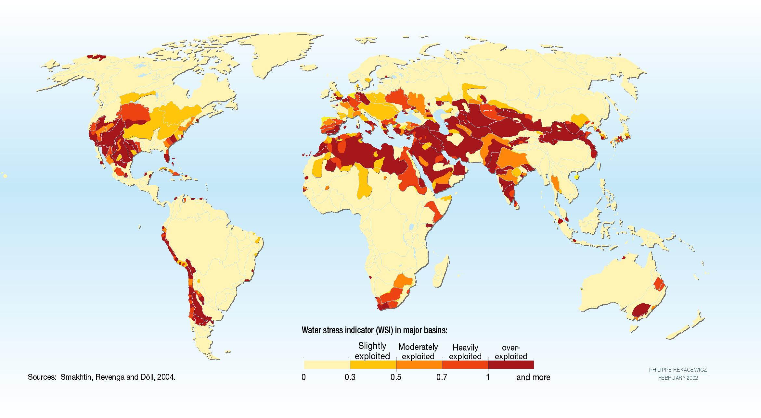
Water Stress Indicator

Slide 8
Water Stress Indicator in 2040

Slide 9
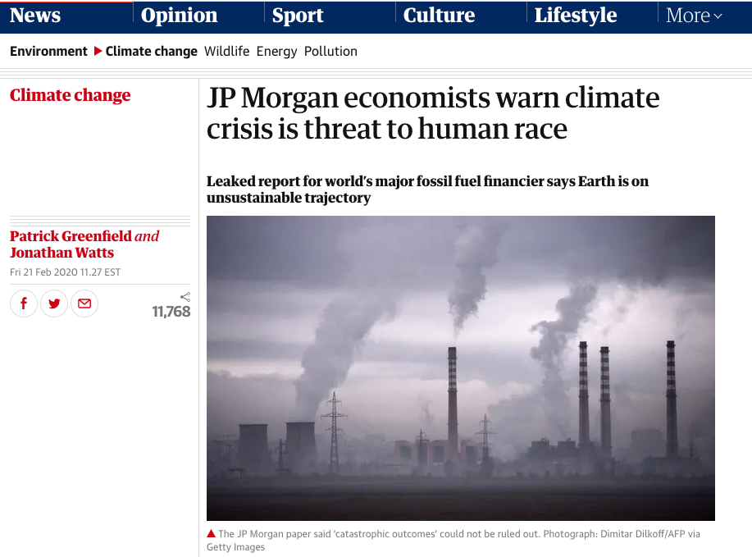
The Guardian

Slide 10
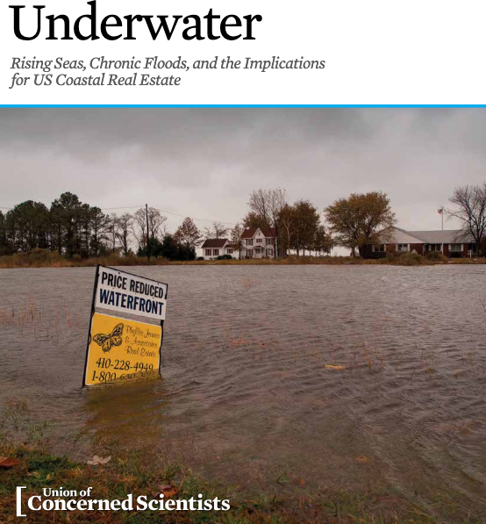

Slide 11
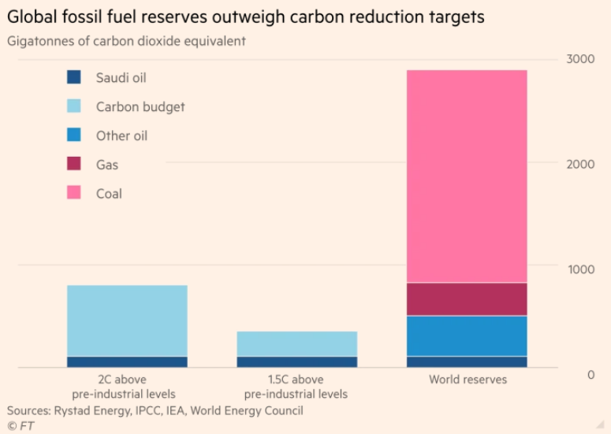
Unburnable Carbon #KeepItInTheGround

Slide 12
Avoiding a Climate Minsky Moment
Climate stress will be priced in sooner rather than later (economic, social, health, political costs)
Renewables will displace fossil fuels on price & efficiency grounds
Climate policy inaction will lead to a “Climate Minsky Moment” with a collapse in financial markets, and trillions in stranded assets.
An orderly transition is preferable: “Soft landing”
The Fed’s role: Green QE, green prudential regs
The Government’s role: Green New Deal, disclosure/transparency regulations

